Slide 1
Licensing Types and Issues.

Slide 2
License??
A permit from an authority to own or use something, do a particular thing, or carry on a trade.
Software License:
A software license is usually an agreement between the author and the user of a software that grants a right to use software code to someone else.

Slide 3
What is Licensing?
When you license your work, you’re not giving away any of your rights. You still hold the original copyright (or patent if you have one) on that work.
What a license does is grant specific permissions for others (what users are permitted do or cannot do as per the terms and conditions) to use that work.
Licensing is a great alternative to just releasing your work into the public domain or granting permissions on a case-by-case basis.

Slide 4
By releasing into the public domain, you relinquish any copyright, and no one is obligated to list you as the original author or contributor.
In the latter case, you may end up spending more time dealing with individual permissions than designing or developing.
Open-source licenses make it easy for others to contribute to a project without having to seek special permission. It also protects you as the original creator, making sure you at least get some credit for your contributions. It also helps to prevent others from claiming your work as their own.

Slide 5

The Licensing
When a developer is considering his or her options for open-source licenses, the first stop should be the Open Source Initiative (OSI).
The group maintains the definition of open source software and certifies licenses that adhere to it.

Slide 6
How is a License Born?
In 1984, a former programmer Richard M. Stallman, founded the ‘Free Software Foundation’ [here in after FSF].
The main technical goal of the FSF was to create an open source Unix-like operating system called ‘GNU.’ Although Stallman was never able to finish the ‘kernel’ (the “central module”) of the GNU operating system, he and other programmers associated with the FSF were able to produce extremely useful and popular pieces of open source software like the GNU EMACS and the GNU C compiler.

Slide 7
Conditions in order to qualify as an OSS license:
The license must keep the ‘source code’ ‘open’ and available.
The license must maintain the integrity of the author’s source code. Also, the license should acknowledge the authorship of the code.
“The license must allow modifications and derived works, and must allow them to be distributed under the same terms as the license of the original software

Slide 8
The license must allow ‘free redistribution’ of the open source software. This can mean that a licensee can make copies of the software and give it away.
However, since ‘free’ in this context means ‘freedom from constraint’ rather than ‘zero price,’ the license should allow the licensee to sell the software.
The rights attached to the program must apply to all to whom the program is redistributed

Slide 9
Licensing agreements
Limited License (LL)
An agreement whereby software is purchased with limits and/or restrictions on the number of copies available for installation or use.
Unlimited Site License (USL)
An agreement whereby software is purchased with no limit on the number of copies available for installation.
Volume Purchase Agreement (VPA)
An agreement whereby software is purchased in large volume at a reduced price. A formal agreement between the University and a software manufacturer or vendor.
End User License Agreement(EULA)
An EULA is a legal contract between the manufacturer and/or the author and the end user of an application. This is mostly used for Proprietary software.

Slide 10
License Types
OSI fall into six distinct types:
Academic Licenses
Reciprocal Licenses
Standards Licenses
Content Licenses
Perpetual licenses
Annual Licenses

Slide 11
Academic Licenses
Academic licenses are designed to provide absolute freedom.
Representing the most ‘free’ of open source licenses, Academic licenses place no requirements whatsoever on the license user — there’s not even a requirement for the user to share modifications or redistribute them.
Examples: BSD, MIT and Apache licenses.
Restrictions
These licenses prohibit the leveraging of the original licensor’s name as an endorsement in marketing efforts.
Other than that, these licenses are truly intended for those who seek complete control over the software, its use, modifications, and subsequent re-releases independently or with another software package.

Slide 12
To distribute or communicate copies of the Original Work and Derivative Works to the public, under any license of your choice that does not contradict the terms and conditions, including Licensor's reserved rights and remedies, in this Academic Free License

Slide 13
Reciprocal Licenses
Like other licenses, Reciprocal licenses grant complete rights to the software’s use to the developer and end user.
The single difference lies in the requirement that any derivatives of the software be released under the same license, and that the source code must be released. The resulting new software must also be free.
Example: GPL

Slide 14
GPL
The GNU General Public License (GPL) is probably one of the most commonly used licenses for open-source projects. The GPL grants and guarantees a wide range of rights to developers who work on open-source projects.
Basically, it allows users to legally copy, distribute and modify software. This means you can:
Copy the software.
Distribute the software however you want.
Charge a fee to distribute the software
Make whatever modifications to the software you want.

Slide 15
Standards Licenses
Standards licenses seek to create a base standard of software and documentation. Modified and redistributed sources usually have to be distributed as patches, so as to not modify the core.
The goal of a standards license is to preserve an existing code base so that the originating author can come back to it and evolve it without difficulty.

Slide 16
Example:
For example, imagine a situation in which a Web application is created to allow importing and exporting between the various popular blog applications. A Web developer grabs the source of this new software and builds in an additional function to migrate and convert specific design elements along with data. Under a standards license, the core app would be distributed with a plug-in to enable the latter new capability.

Slide 17
Content Licenses
Finally, Content licenses cover elements aside from code, such as art, copy and audio/video.
Creative Commons.
Example: Academic Free License.

Slide 18
Perpetual Licenses
A perpetual license will allow the customer to use the licensed software indefinitely.
For the first year, the perpetual license also entitles the customer to download all updates to the software and to receive technical support.
After the one year period ends, the customer can choose to remain with the last version downloaded or to purchase a 1 year Updates.

Slide 19
Annual License
An annual license will allow the customer to use the licensed software for one year, and entitle the customer to download all updates to the software and to receive technical support.
After the one year period ends, the software will no longer function unless a new license is purchased.

Slide 20
WEB BROWSER
Browser, short for web browser, is a software application used to enable computers users to locate and access web pages.
An information resource is identified by a Uniform Resource Locator (URL) and may be a web page, image, video, or other piece of content.
Although browsers are primarily intended to access the World Wide Web, they can also be used to access information provided by web servers in private networks or files in file systems.

Slide 21
Features
User interface: Most major web browsers have these user interface elements in common:
Back and forward buttons to go back to the previous resource and forward respectively.
A refresh or reload button to reload the current resource.
A stop button to cancel loading the resource. In some browsers, the stop button is merged with the reload button.
A home button to return to the user's home page.
An address bar to input the Uniform Resource Identifier (URI) of the desired resource and display it.
A search bar to input terms into a search engine. In some browsers, the search bar is merged with the address bar.

Slide 22
Features
Privacy and security
Most browsers support HTTP Secure and offer quick and easy ways to delete the web cache, cookies, and browsing history.
Standards support
Early web browsers supported only a very simple version of HTML. With the rapid development of commercial web browsers Modern web browsers support a combination of HTML and XHTML and others.
Extensibility
A browser extension is a computer program that extends the functionality of a web browser. Every major web browser supports the development of browser extensions.

Slide 23







Different types of browser
Text based Browser
  LYNX
GUI based Browser
  IE
  Mozilla
  Firefox
  Safari
  Opera
  Konqueror

Slide 24
Details of web browsers
Internet Explorer
Internet Explorer (IE) is a product from software giant Microsoft. This is the most commonly used browser in the universe.
Netscape
Netscape is one of the original Web browsers. This is what Microsoft designed Internet Explorer to compete against.
Mozilla
Mozilla is an open-source Web browser, designed for standards compliance, performance and portability.
Firefox
Firefox is a new browser derived from Mozilla. It was released in 2004 and has grown to be the second most popular browser on the Internet.
Konqueror
Konqueror is an Open Source web browser with HTML 4.01 compliance, supporting Java applets, JavaScript, CSS 1, CSS 2.1, as well as Netscape plugins.

Slide 25
Details of web browsers
Safari
Safari is a web browser developed by Apple Inc. and included in Mac OS X. It was first released as a public beta in January 2003. Safari has very good support for latest technologies like XHTML, CSS2 etc.
Opera
Opera is smaller and faster than most other browsers, yet it is full- featured. Fast, user-friendly, with keyboard interface, multiple windows, zoom functions, and more.
Lynx
Lynx is a fully-featured World Wide Web browser for users on Unix, VMS, and other platforms running cursor-addressable, character-cell terminals or emulators.

Slide 26
Web Servers
Basic Definition
Server: provides services
Client: requests for services
Service: any resource
(e.g., data, file, control, object, CPU time, display device, etc.)
Specific types of clients include web browsers.
Specific types of servers include web servers, ftp servers, application servers, database servers, mail servers, file servers, print servers.

Slide 27
Web Server
Web server can refer to either the hardware (the computer) or the software (the computer application) that helps to deliver content that can be accessed through the Internet.
The most common use of web servers is to host web sites but there are other uses such as data storage or running enterprise applications.

Slide 28





Types of web servers
Apache HTTP Server
IIS
lighttpd
Sun Java System Web Server
jigsaw (W3C's Server)

Slide 29
Details of Web Servers
Apache HTTP Server
This is the most popular web server in the world developed by the Apache Software Foundation. Apache web server is an open source software and can be installed on almost all operating systems including Linux, Unix, Windows, FreeBSD, Mac OS X and more. About 60% of the web server machines run the Apache Web Server.
IIS
The Internet Information Server (IIS) is a high performance Web Server from Microsoft. This web server runs on Windows NT/2000 and 2003 platforms ( and may be on upcoming new Windows version also). IIS comes bundled with Windows NT/2000 and 2003; Because IIS is tightly integrated with the operating system so it is relatively easy to administer it.

Slide 30
Web Servers cont…
lighttpd
The lighttpd, pronounced lighty is also a free web server that is distributed with the FreeBSD operating system. This open source web server is fast, secure and consumes much less CPU power. Lighttpd can also run on Windows, Mac OS X, Linux and Solaris operating systems.
Sun Java System Web Server
This web server from Sun Microsystems is suited for medium and large web sites. Though the server is free it is not open source. It however, runs on Windows, Linux and Unix platforms. The Sun Java System web server supports various languages, scripts and technologies required for Web 2.0 such as JSP, Java Servlets, PHP, Perl, Python, Ruby on Rails, ASP and Coldfusion etc.
jigsaw (W3C's Server)
comes from the World Wide Web Consortium. It is open source and free and can run on various platforms like Linux, Unix, Windows, Mac OS X Free BSD etc. Jigsaw has been written in Java and can run CGI scripts and PHP programs.

Slide 31
HTTP
HTTP Request Response Protocol
Client side scripting
Server side scripting

Slide 32
Copyright
Copyright is a bundle of rights granted to a creator providing him with exclusive rights over his original artistic and literary creation.
It is not necessary that a copyright be registered, it is attached automatically to any original artistic work.
When the idea of a creator is converted to a material form, the same immediately gets protected under the copyright.
For a work to be copyrighted, it is necessary that the work is original work of literature, drama, music, or any other art having artistic value.

Slide 33
The bundle of rights granted to the copyright owner includes the rights to reproduce, copy, publish, communicate, and translate the copyrighted work.
Such a right is a natural right granted to the owner of the artistic work immediately on the making of the same.

Slide 34
What are the Benefits of Copyright Registration?
Copyright registration is essential when some creative work is done and acclamation/protection to its creator is to be given legally.
Also, it restricts others to use the copyrighted work for a commercial or domestic purpose and a person cannot use it without prior permission of the owner.
Website link- https://copyright.gov.in/

Slide 35
What Documents are Required for Copyright Registration?
Particulars of the Applicant (ID and Address proof of the applicant along with the Nationality)
Name, address, and nationality of the author of the work
Disclosure of the applicant’s interest in the copyright - whether he/she is the author of the work or the representative of the author.
Copies of the original work.

Slide 36
In case for business purpose-Incorporation certificate is required.
Details of the nature of the work
Class, Title & Description of the Work
Language of the Work
Date of Publication - Publication in internal magazines or a research paper submitted to a professor does not count as publication.
Apart from the basic documents required for copyright registration, submit documents as per copyright categorization.

Slide 37
What is the Registration Procedure for Filing the Copyright Registration?
Step-1-
Creating User ID and Password Before filing the application form for Copyright registration, the applicant needs to use the User ID and password for login. If the applicant is not registered while applying, then he/she is required to opt for New User Registration.

Slide 38
Step-2-Filing Application Form
An applicant can apply either manually in the copyright office or through an e-filing facility available on the official website (copyright.gov.in). Here, the applicant can be an author of the work/owner of an exclusive right for the work/an authorized agent.
After login, an applicant needs to click on “Click for online Copyright Registration” and shall fill the online “Copyright Registration Form” along with all the requisite documents. The Registrar will issue a dairy number to the applicant, once the Copyright application is filed.

Slide 39
Step 3-Examination of Application Once the application is filed; the very next step is to examine the copyright application. Once the dairy number is issued, a minimum of 30 days waiting period is provided where the copyright examiner can review the application.

Slide 40
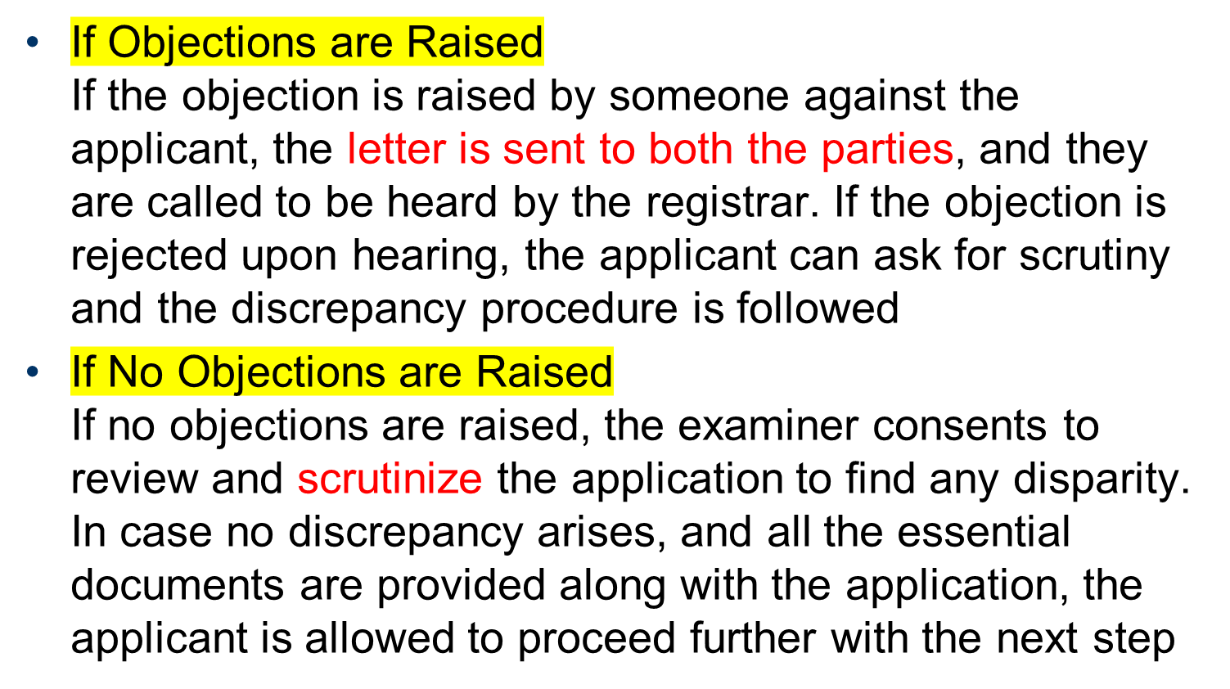
After examination, the process of Copyright Registration gets divided into two segments:-
.

Slide 41
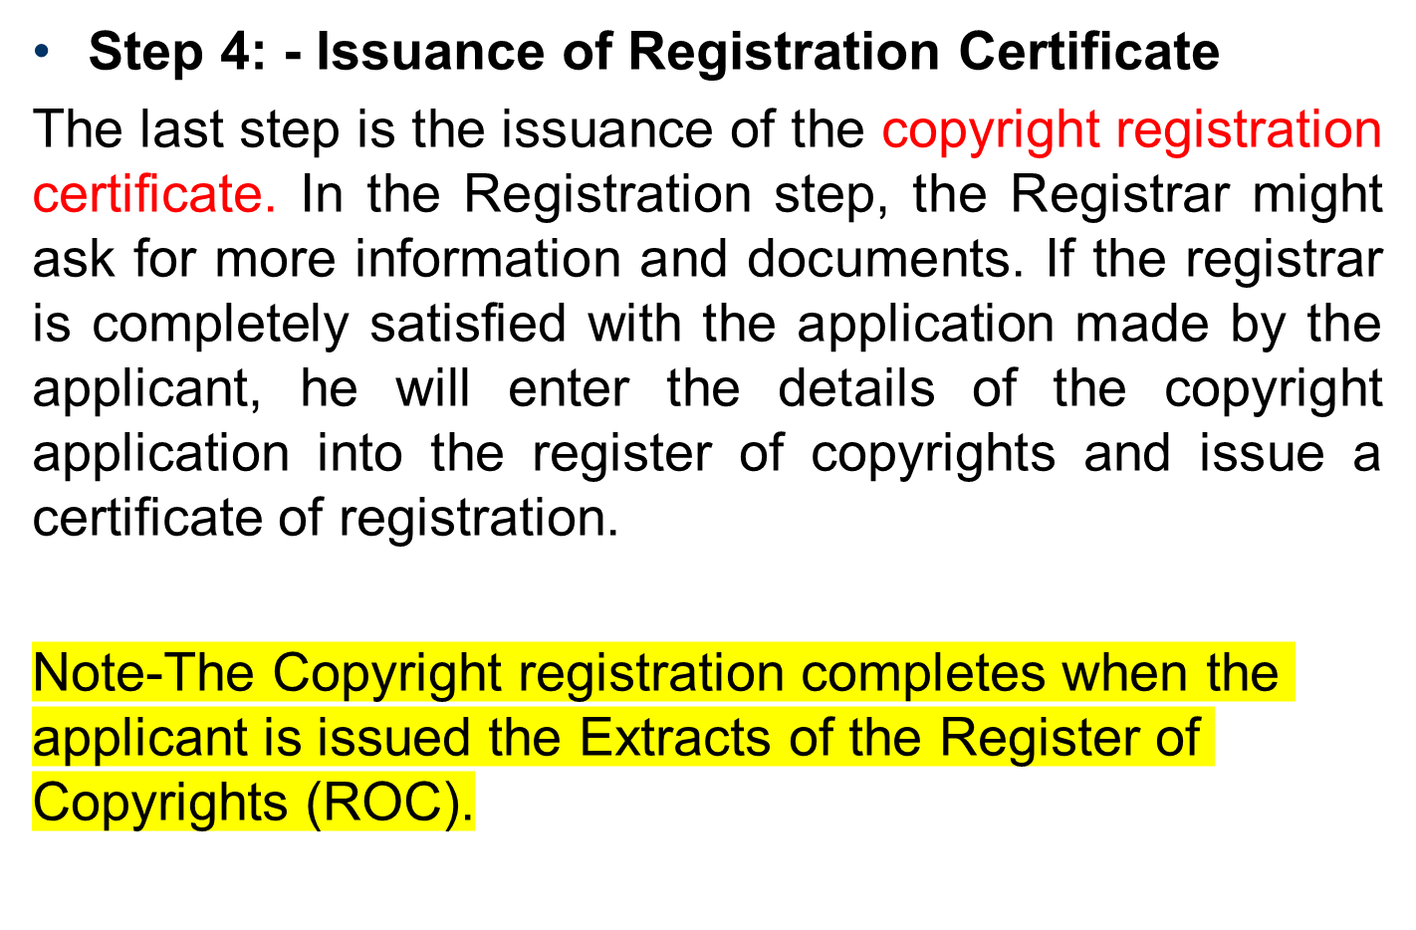

Slide 42
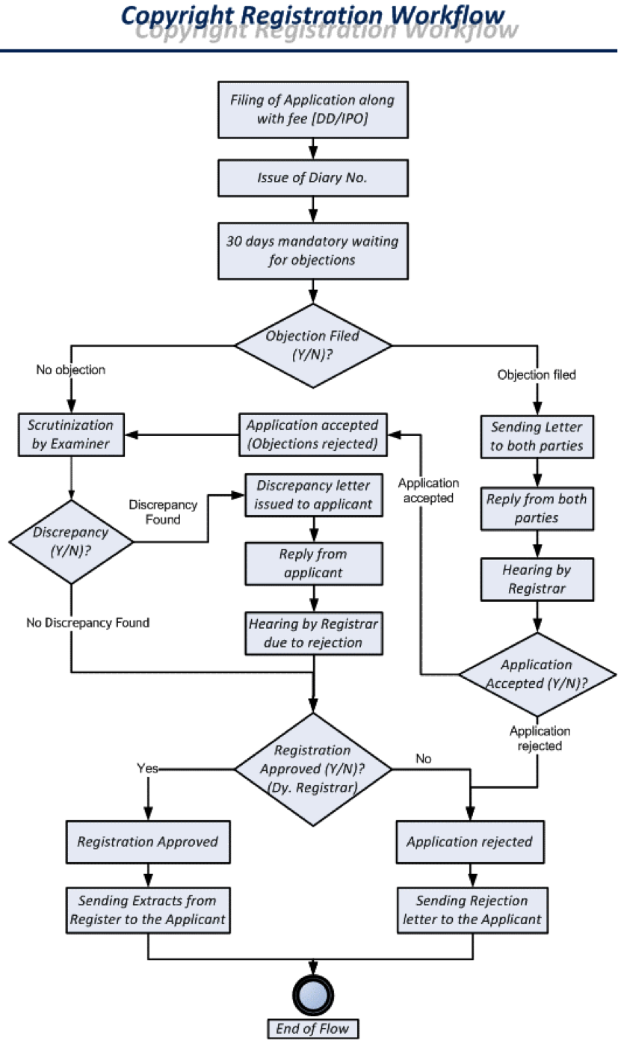

Slide 43
What is the Validity Period for Copyright Registration?
In case of Published Works The duration of the copyright artistic works is valid up to the life of the artist + 70 years.
In the case of Unpublished Works Copyright lasts until the work is first published to a span of the life of the artist + 70 years.
Note: - As per the changes made *From 1 January 2019, the duration of copyrighted art is the same for both published and unpublished works.

Slide 44

CopyLeft
Most of the creative works, including software programs and codes, comes within the domain of copyright protection and therefore can be copyrighted.
However, it is to be noted that software and programming is an area where already existing programs many-a-times are used as a base to build new software or program.
It is for this reason, many software owners tend to grant a license to its users a license allowing them to modify and alter their work. Such permission and license can be referred to as Copyleft.

Slide 45
Copyleft can be said to be a specific kind of a license that allows free use of copyrighted material but under certain terms and conditions, granted by the owner of the copyright himself.
For instance, software having a copylefted license can be modified, used, distributed, or reproduced provided the source code kept open and available to the public
Copyleft is a license that provides original work to a third person giving him certain rights like that of copying and modifying and any new work carved out based on such original work shall have a copyleft license in a similar manner.

Slide 46
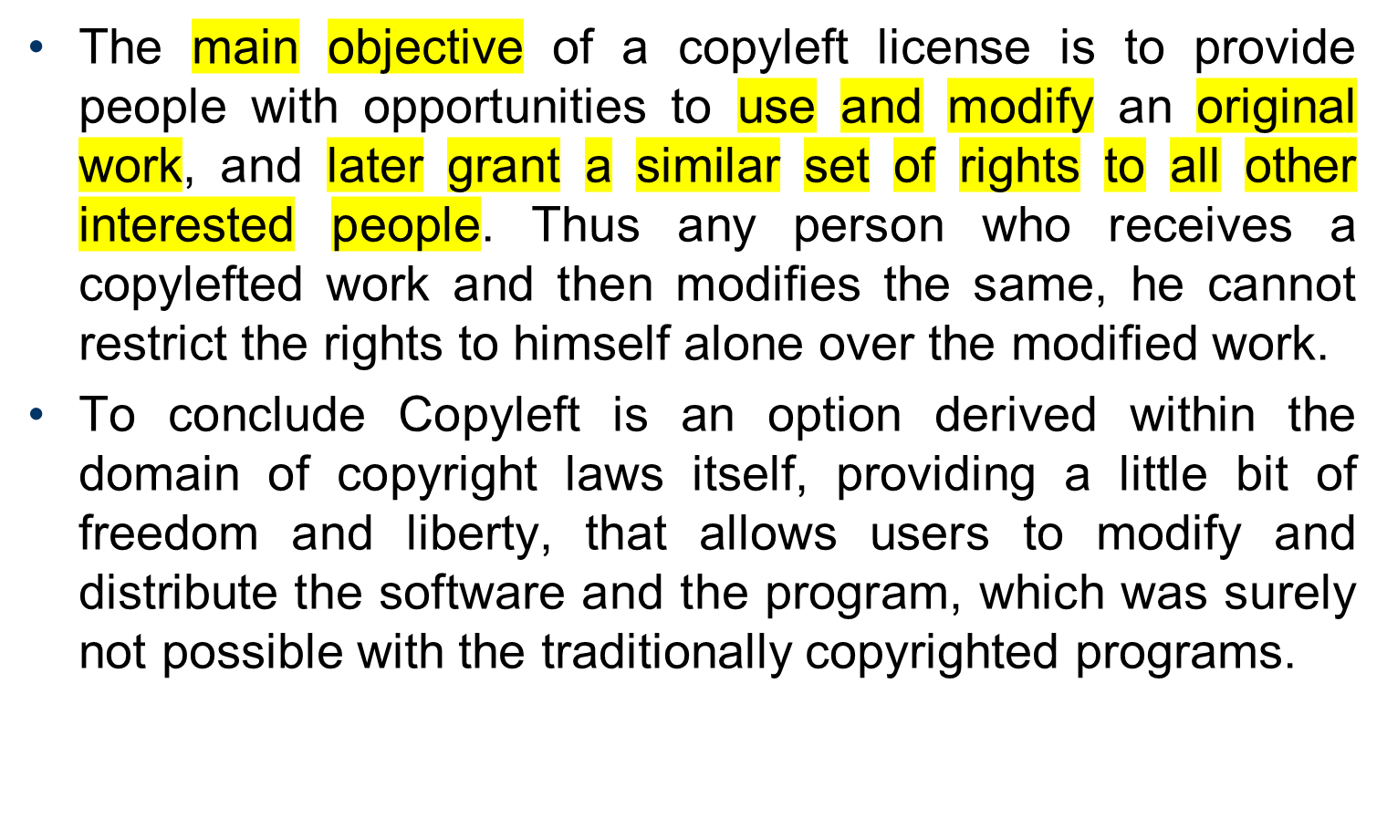

Slide 47
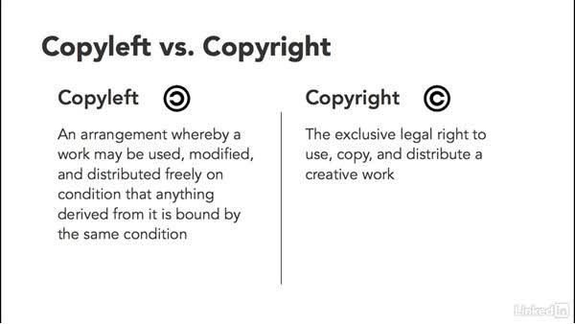

Slide 48

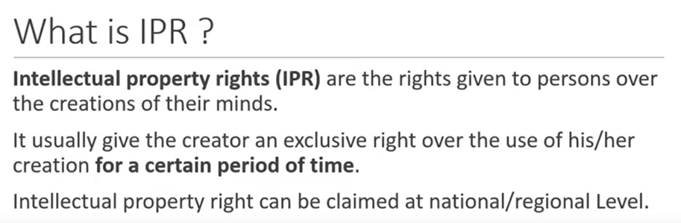

Slide 49


Examples
You Tube video
Any website content, software etc

Slide 50
Need of IPR
Encourages innovation: The legal protection of new creations encourages the commitment of additional resources for further innovation.
Economic growth: Promotion and protection of intellectual Property promote economic development, generates new jobs and industries, and improves the quality of life.
Safeguard the rights of creators: IPR is required to safeguard creators and other producers of their intellectual commodity, goods and services by granting them certain time-limited rights to control the use made of the manufactured goods.
It promotes innovation and creativity and ensures ease of doing business.
It facilitates the transfer of technology in the form of foreign direct investment, joint ventures and licensing.

Slide 51
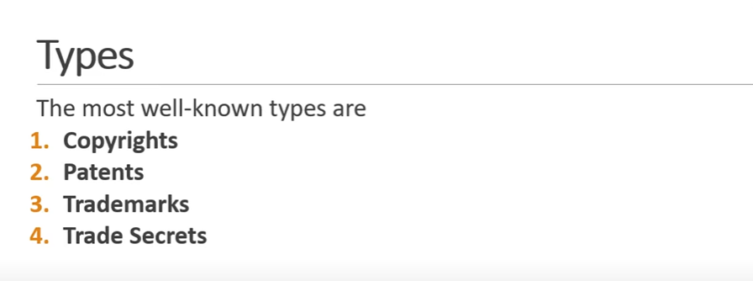

Slide 52
The Copyrights Act, 1957 (“Copyright Act”)
The Copyright Act, under section 17, clearly states that the author of the original work (for which protection under copyright has been obtained) shall be the first owner of the work.
Further, the owner has the right to license the copyright of their work to third-parties through a written agreement.

Slide 53
The Patents Act, 1970 (“Patents Act”)
A ‘Patent’ is an intellectual property right which protects any new invention.
It is an exclusive right that protects the rights of the inventor and prevents other people to unauthorizedly use and misappropriate the registered patent.
A patent is granted for a term of 20 (twenty) years from the date of filling of the application.
It is important to note that patent for a new invention is registered only if the invention is ‘novel’ and ‘original’ i.e. it has not been introduced in the public domain in India or anywhere in the world.

Slide 54
The Trade Marks Act, 1999 (“Trade marks Act”)
The Trade Marks Act, under section 2(zb) defines a ‘trade mark’ as ‘a mark capable of being represented graphically and which is capable of distinguishing the goods or services of one person from those of others and may include shape of goods, their packaging and combination of colour”.
In simpler words, a trademark provides protection for symbols, colours, shapes, words, etc. representing and relating to a good or a service.

Slide 55
The primary requirements for registration of a trademark includes that it should consist of a mark capable of distinguishing the goods/services from those of others and that it is capable of graphical representation.
The Trade Marks Act provides for absolute grounds of refusal of registration such as –
(a) the mark not having a distinctive character;
(b) a mark being deceptive and confusing to the public;
(c) if a mark is hurtful to religious sentiments;
(d) the mark is offensive, scandalous, or obscure, etc. In addition to the absolute grounds of refusal, the statute also provides for relative grounds of refusal of registration (viz. similarity with pre-existing marks).

Slide 56
Further, India is a signatory to the Madrid Protocol under which a trademark can be applied for and registered internationally. However, the prerequisite for filing and registering an international application (under the Madrid Protocol) in a foreign jurisdiction is that the mark needs to be first filed in India.
A protection afforded from a trademark registration is imperative as it protects the brand name, logo, sound, shape, etc., and distinctively identifies the goods/services to the brand bringing uniqueness to the mark. Also, the validity of a trademark registration is for an initial period of 10 (ten) years which can renewed perpetually for successive period of 10 years (subject to timely filing of renewal application

Slide 57
The Design Act, 2000 (“Design Act”)
A ‘design’ under the Designs Act [section 2(d)] means and includes ‘only the features of shape, configuration, pattern, ornaments or composition of lines or colours, applied to any article whether in two dimensional or three dimensional or in both forms, by any industrial process or means, whether manual, mechanical or chemical, separate or combined, which in the finished article appeal to an are judged solely by the eye’.

Slide 58
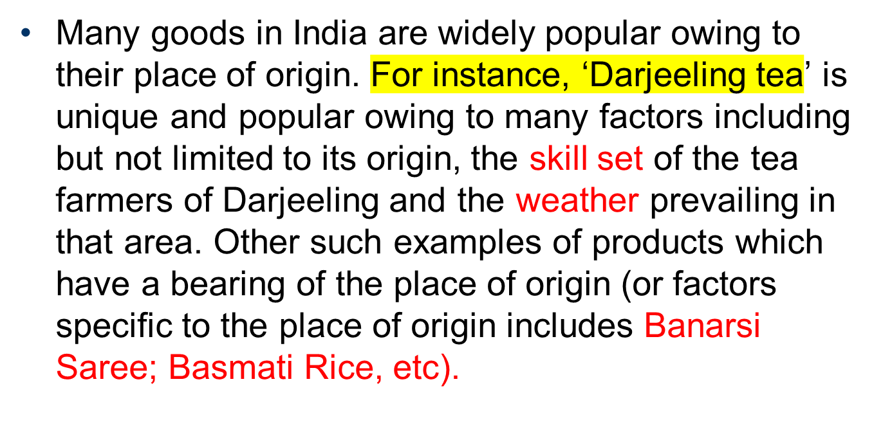
The Geographical Indications of Goods (Registration and Protection) Act, 1999 (“GI Act”)

Slide 59
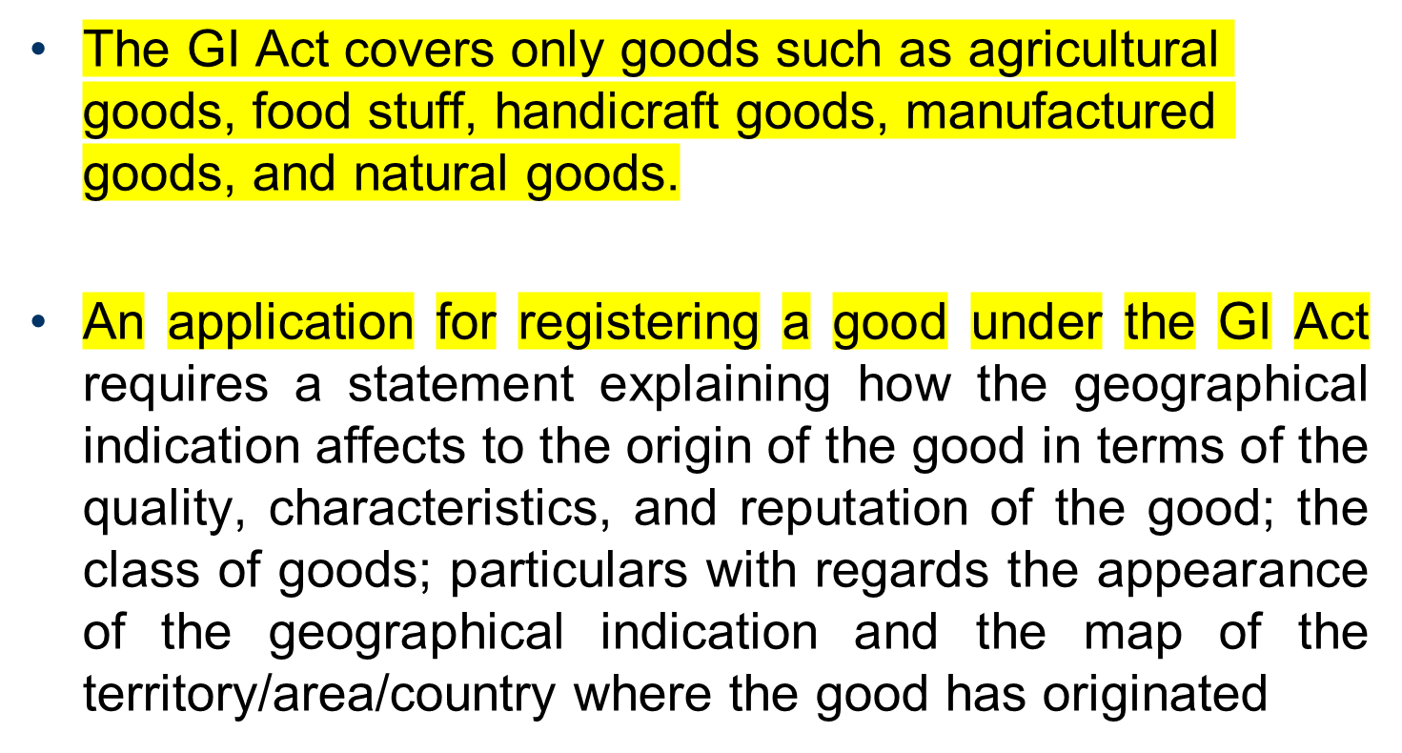

Slide 60
Trade Secrets
Trade secrets are intellectual property (IP) rights on confidential information which may be sold or licensed. In general, to qualify as a trade secret, the information must be:
commercially valuable because it is secret,
be known only to a limited group of persons, and
be subject to reasonable steps taken by the rightful holder of the information to keep it secret, including the use of confidentiality agreements for business partners and employees.

